Slide 1
INTERFACES

Slide 2
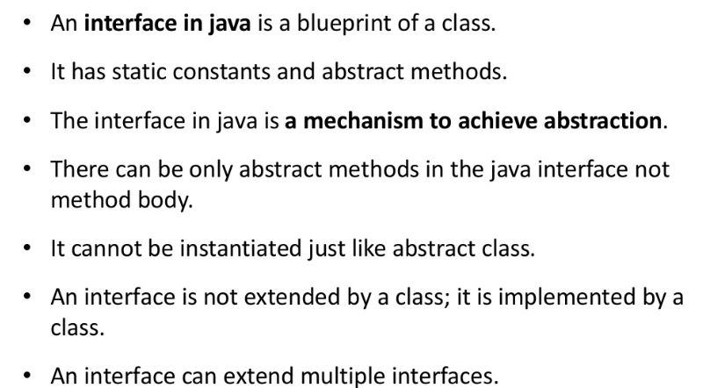

Slide 3
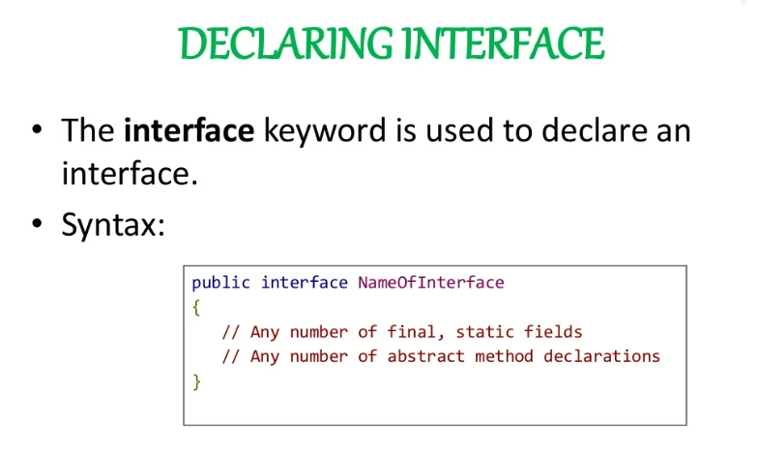

Slide 4
Why interfaces are required ?
Interfaces allow you to implement common behaviors in different classes that are not
related to each other
Interfaces are used to describe behaviors that are not specific to any particular kind of
object, but common to several kind of objects
Defining an interface has the advantage that an interface definition stands apart from any class or class hierarchy
This makes it possible for any number of independent classes to implement the interface

Slide 5
Why interfaces are required ?
Thus, an interface is a means of specifying a consistent specification, the implementation of which can be different across many independent and unrelated classes to suit the respective needs of such classes
Interfaces reduce coupling between components in your software
Java does not support multiple inheritance
This is a constraint in class design, as a class cannot achieve the functionality of two or more classes at a time
Interfaces help us make up for this loss as a class can implement more than one interface at a time
Thus, interfaces enable you to create richer classes and at the same time the classes need not be related

Slide 6
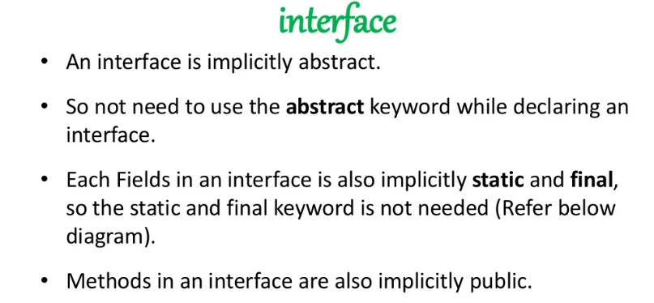
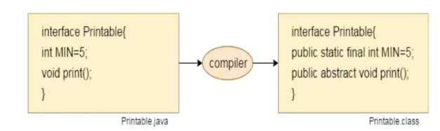

Slide 7
Interface members
All the methods that are declared within an interface are always, by default, public and abstract
Any variable declared within. an interface is always, by default, public static and final

Slide 8
Default Method in Interface
Interface Inf1{
default return type method name(args)
{
//statements
}
}

Slide 9
Static method in Interface
Interface Inf1
{
static return type method name(args)
{
//statements
}
}

Slide 10
Private method in interface
Interface Inf1
{
private return type method name(args)
{
//statements
}
}

Slide 11
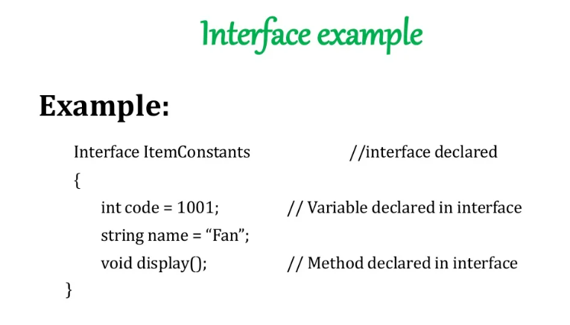

Slide 12
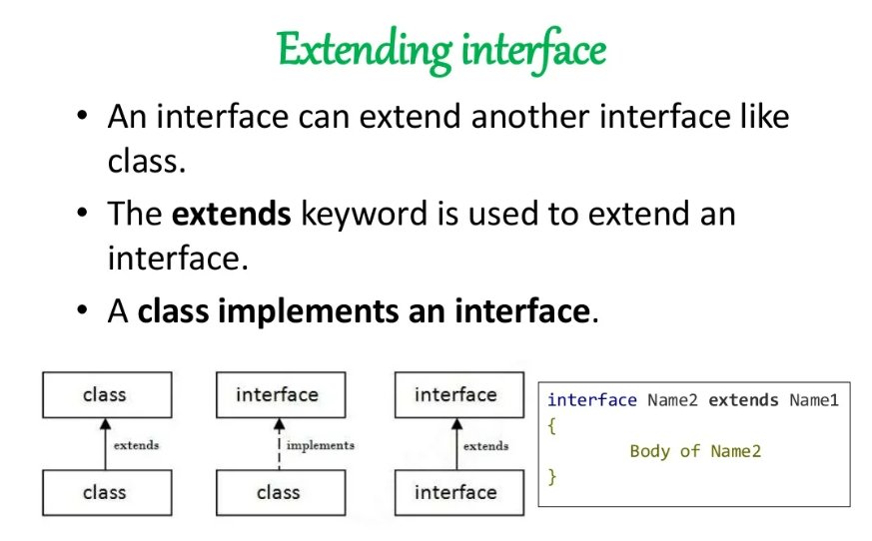

Slide 13
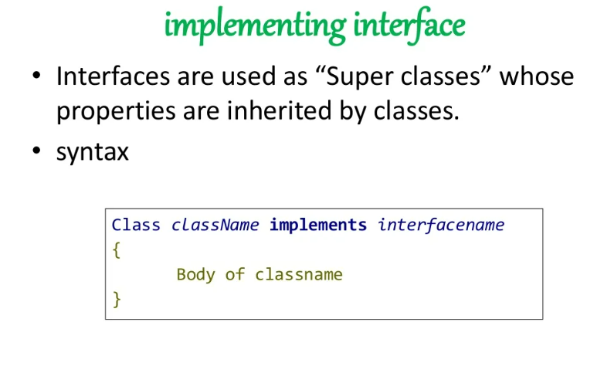

Slide 14
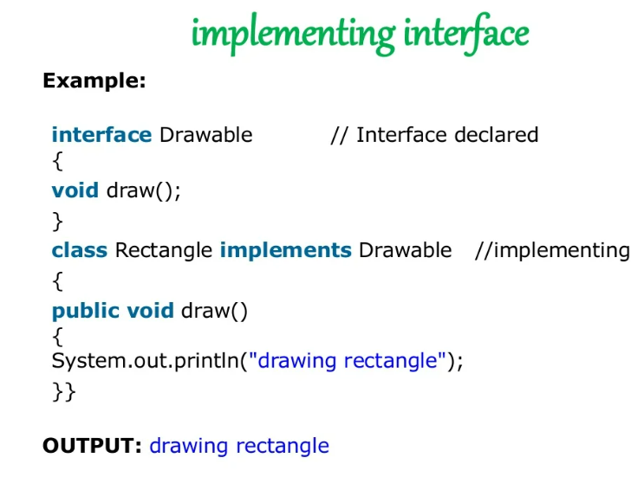

Slide 15
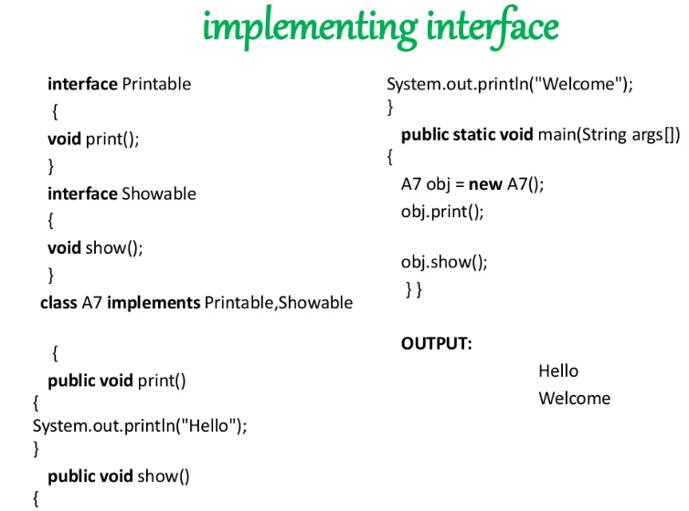

Slide 16
Quiz
Will the following code compile successfully ?
interface I1 {
private int a=100;
protected void m1();
}
class A1 implements I1 {
public void m1() {
System.out.println(“In m1 method”);
}
}

Slide 17
Quiz
interface I1 {
static int a=100;
static void m1();
}
class A1 implements I1 {
public void m1() {
System.out.println(“In m1 method”);
}
}

Slide 18


Slide 19
Package is similar to folders in your Disk
People normally group their related data in various folders.
▪ For example, a programmer may group his programs into the following folders.
▪ C_programs, CPP_programs, SQL_queries, PLSQL_programs.. etc.
▪ We also use sub-folders for organizing our data more conveniently.
▪ The advantage is we can easily locate the files if they are organized.

Slide 20
Need for packages
Till now, you did not use any package since all your classes were stored in the default package. Imagine a situation where all the classes are stored in one package.
It would lead to tremendous confusion as it may lead to classes with similar names that is not allowed by the language.
This scenario is also referred to as a namespace collision.

Slide 21
Need for packages
Packages are containers used to store the classes and interfaces into manageable units of code.
Packages also help control the accessibility of your classes. This is also called as visibility control.
▪ Example:
package MyPackage;
class MyClass {...}
class YourClass{...}

Slide 22
Access Protection using Packages
Packages facilitate access-control
Once a class is packaged, its accessibility is controlled by its package
That is, whether other classes can access the class in the package depends on the access specifiers used in its class declaration
There are four visibility control mechanisms packages offer:
▪ private
▪ no-specifier (default access)
▪ protected
▪ public

Slide 23
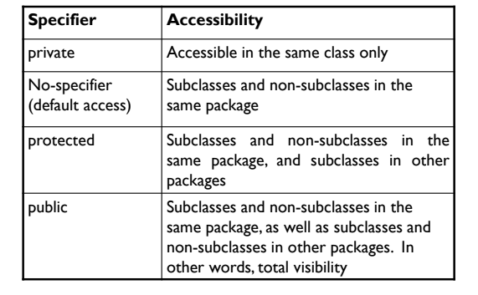
Access Protection using Packages

Slide 24
Packages are containers for classes.
They are used to keep the class name space
compartmentalized.
Packages are stored in a hierarchical manner and are
explicitly imported into new class definitions.

Slide 25
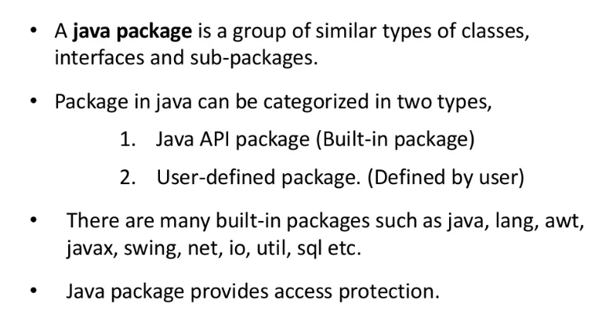

Slide 26
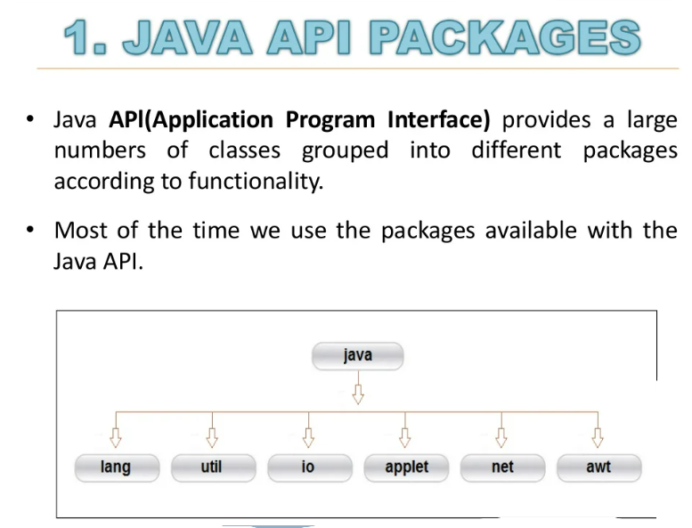

Slide 27
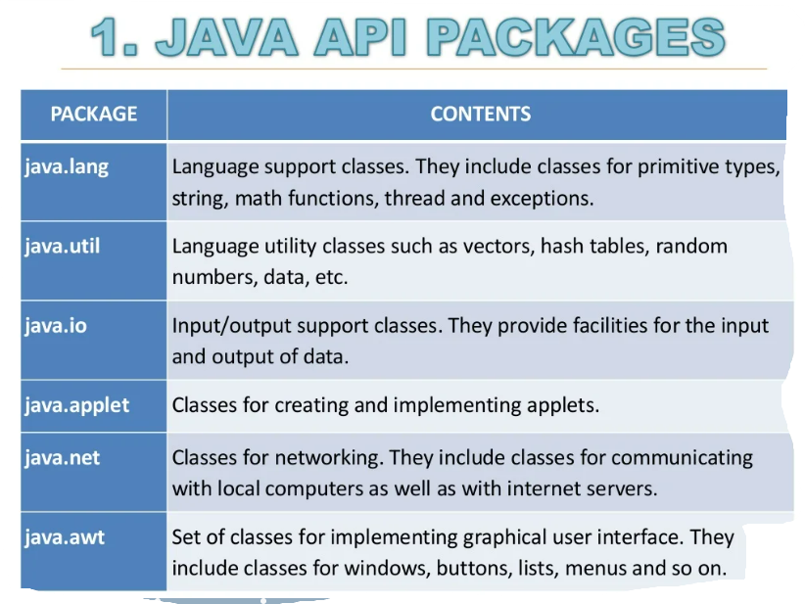

Slide 28
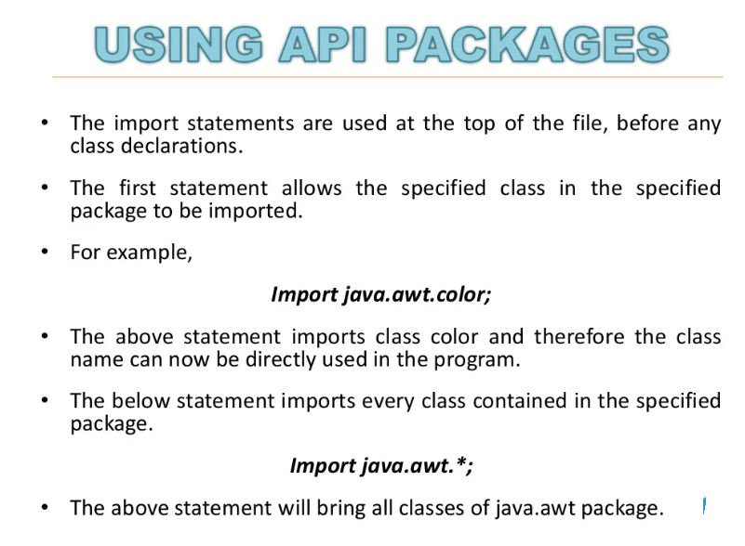

Slide 29
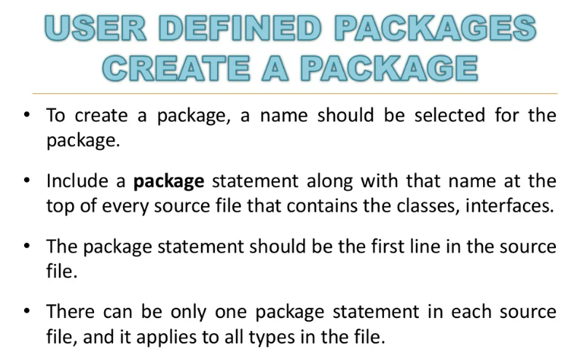

Slide 30
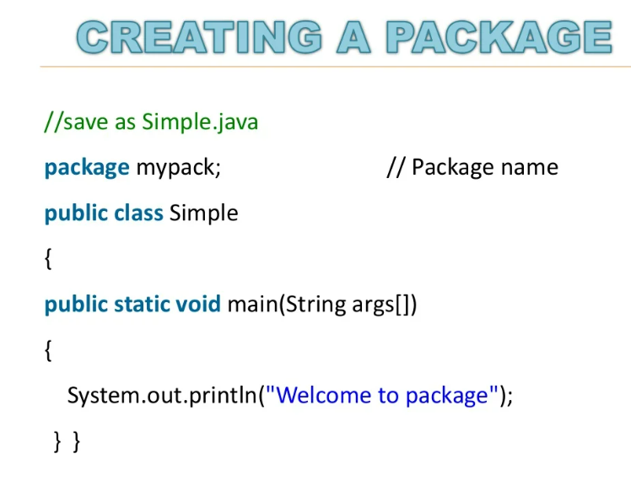

Slide 31
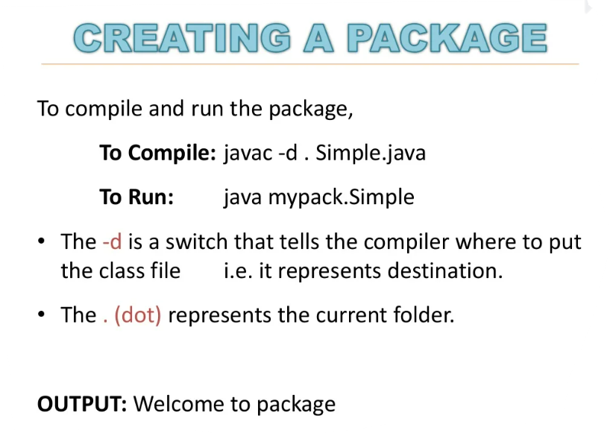

Slide 32
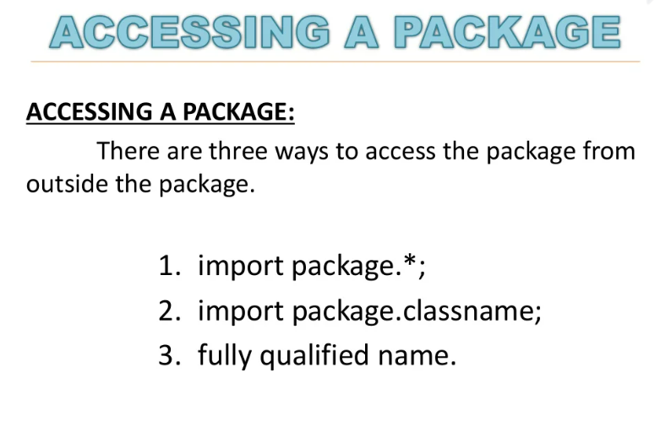

Slide 33
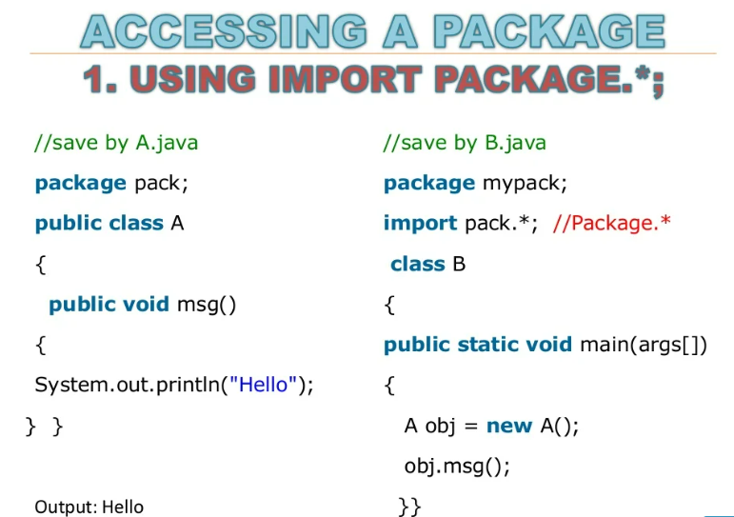

Slide 34
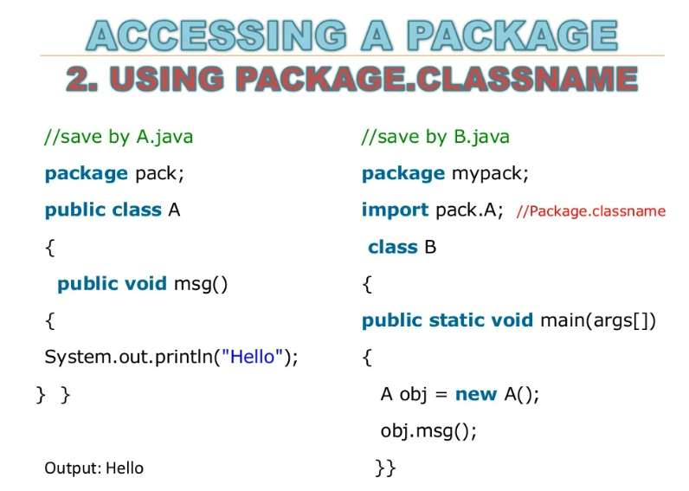

Slide 35
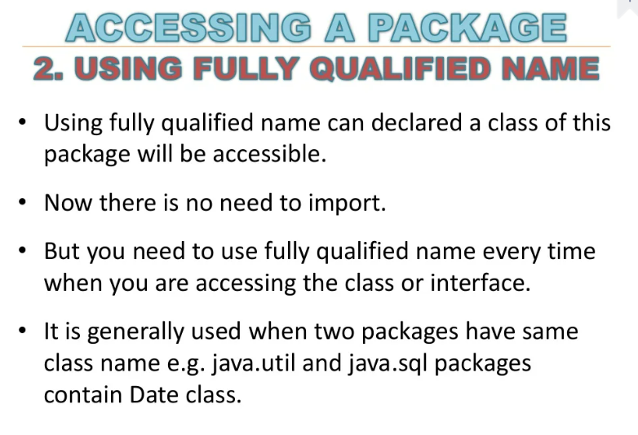

Slide 36
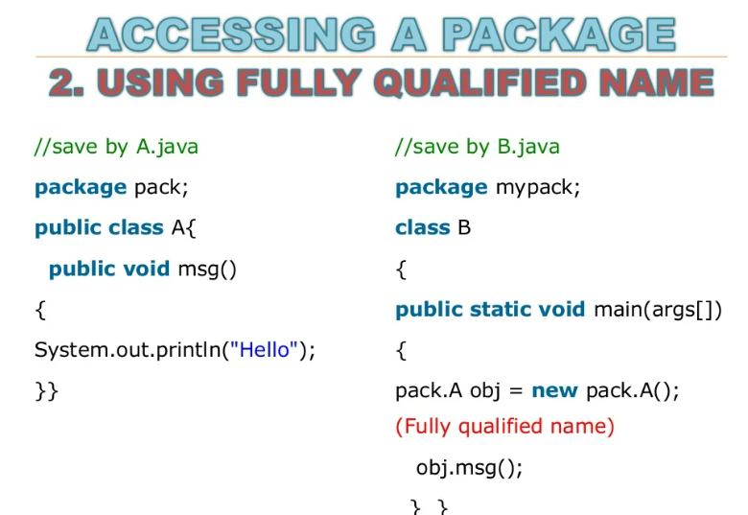

Slide 37
Quiz
Which is not a correct inbuilt java package?
A) java.io
B) java.sql
C) java.dbms
D) java.net

Slide 38
Quiz
Which is a correct inbuilt java package?
A) java.text
B) java.errors
C) java.dbms
C) java.network

